Slide 1
Outline Of Today’s Discussion
Dalton – The Color Challenged Monkey
Introduction to Color Perception
Color Metamers
Powerpoint’s Color Wheel

Slide 2
Part 1
Dalton:
The Color Challenged Monkey

Slide 3
Part 2
Introduction To Color Vision

Slide 4
Introduction To Color Vision
Color is like “intelligence” in that it is one word which describes a MULTI-DIMENSIONAL phenomenon.
The three commonly studied dimensions of color are Hue, Saturation, and Brightness.
Let’s consider each of these in turn…

Slide 5
Introduction To Color Vision
Perceptually, hue is the dimension of color that distinguishes among red, orange, yellow, green, and blue, as some examples.
Physically, hue is the dimension of color most strongly determined by light’s wavelength.
Let’s look at the collection of wavelengths, ie., the spectrum….

Slide 6
Introduction To Color

Slide 7
Hue & Wavelength
Green
Yellow
Intensity
Short
530
590
Long
Wavelength (nm)

Slide 8
Introduction To Color
Can someone show me where PINK is?

Slide 9
Introduction To Color Vision
Perceptually, saturation is the dimension of color that distinguishes pink from red, as one example.
Physically, saturation is the dimension of color most strongly determined by the extent to which a light is LOCALIZED in the spectrum.
A perfectly localized light would be “mono-chromatic”, and would be a laser: It would be completely saturated.
A completely “non-localized” (broadband) light would appear achromatic. It would be completely de-saturated.

Slide 10
Saturation & Localization
If this
is red…
Intensity
Short
Long
Wavelength (nm)

Slide 11
Saturation & Localization
Then this
is pink…
Intensity
Short
Long
Wavelength (nm)

Slide 12
Introduction To Color Vision
Perceptually, brightness is the dimension of color that distinguishes “fire-engine-red” from maroon.
Physically, brightness is the dimension of color that distinguishes the amount of light emitted by an object.

Slide 13
Brightness & Intensity
If this
is red…
Intensity
Short
Long
Wavelength (nm)

Slide 14
Brightness & Intensity
Then this
is maroon…
Intensity
Short
Long
Wavelength (nm)

Slide 15
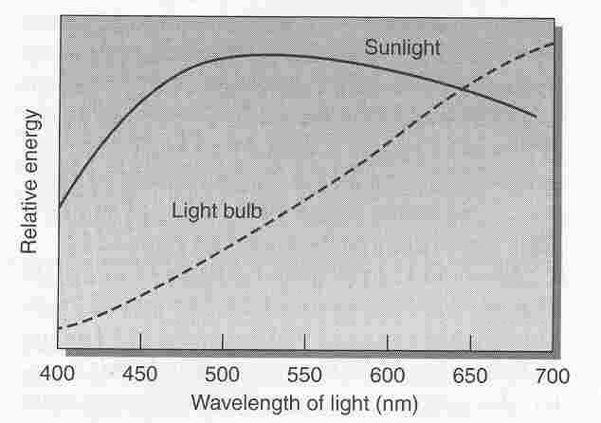
Introduction To Color
The Spectrum of Some Common Light Sources

Slide 16
Introduction To Color Vision
What is color for?
Color can be used to make objects conspicuous…

Slide 17
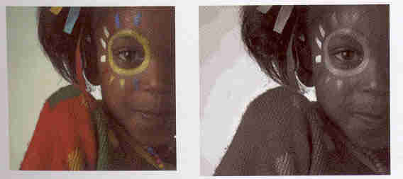
Introduction To Color
Color Makes Objects Conspicuous.
Isoluminant colors have the same intensity.
(Where’s the green shoulder-patch in right photo?)

Slide 18
Introduction To Color Vision
Color can also be used to make objects inconspicuous, that is, for camouflage…

Slide 19
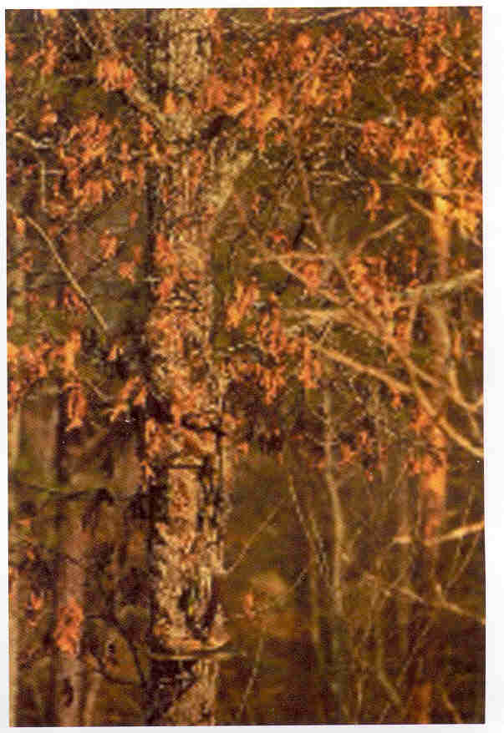
Introduction To Color
Color Makes Objects Inconspicuous

Slide 20
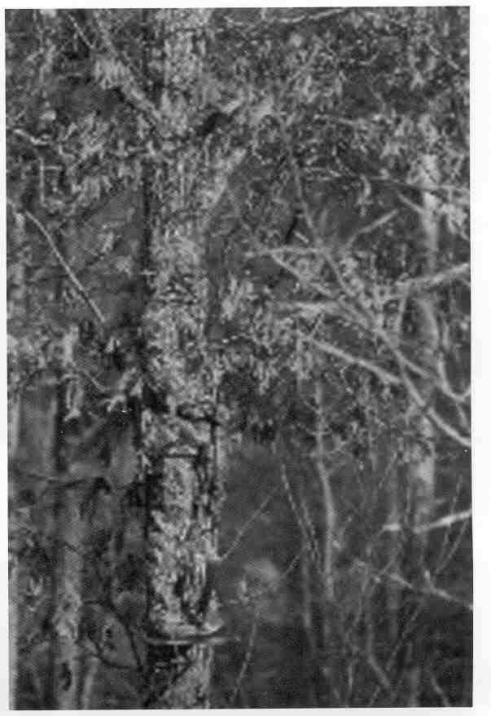
Introduction To Color

Slide 21
Part 3
Color Metamers

Slide 22
Color Metamers
Metamers are physically different stimuli that are perceptually indistinguishable.
Here are some color metamers. Name the colors you see in the next slide…

Slide 24
Color Metamers
Close one eye, and place the “red” (i.e., long wave pass) filter in front of your other eye.
Now, what color is seen in the center bar….

Slide 26
Color Metamers
Finally, place the “blue” (i.e., short wave pass) filter in front of your eye.
Now, what color is seen in the center bar….

Slide 28
Color Metamers
To the naked eye, the center bar always appeared yellow. It did NOT appear to be “greenish-red”
The filters reveal that the yellow experience was composed of “green” and “red” light.
Consider a canary yellow paper board. It’s spectral composition would be a single, well localized spike, near 590 nm.

Slide 29
Spectrum of Yellow Paperboard
You can’t
distinguish
this…..
Yellow
Intensity
Short
590
Long
Wavelength (nm)

Slide 30
Spectrum of Center Bar in Demo
from this!
Intensity
Green
Red
Short
590
Long
Wavelength (nm)

Slide 31
Color Metamers
That was an example of color metamers: Physically different spectra gave rise to indistinguishable perceptual experiences.
Here’s another example of color metamers.

Slide 32
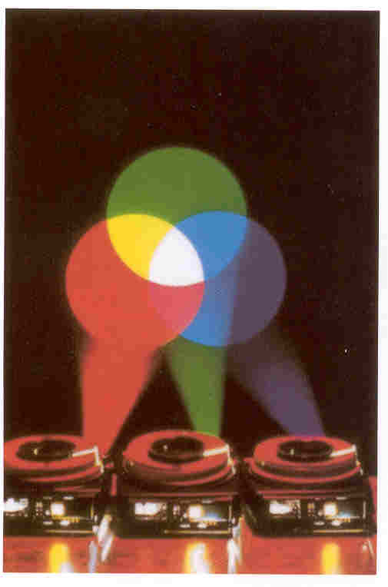
Color Metamers

Slide 33
Spectrum of RGB “White”
You can’t
distinguish
this…..
Blue
Green
Red
Intensity
Short
Long
Wavelength (nm)

Slide 34
Spectrum of Broadband “White”
from this!
Broadband
Intensity
Short
Long
Wavelength (nm)

Slide 35
Part 4
Demo:
PowerPoint’s Color Wheel

Slide 36
PowerPoint’s Color Wheel
Using Powerpoint’s color wheel, let’s change some background colors…quantitatively….

Slide 37
PowerPoint’s Color Wheel
The International Commission of Illumination (Commission Internationale de l’Eclairage, C.I.E.) has a 3-coordinate system for describing color balances.
The coordinates are decimals, respectively corresponding to Red, Green, and Blue (RGB).
The three “C.I.E. Coordinates” must always add to 1.
So, we only need to specify the first two, and the third (blue) = 1 - (R + G).
Example: If R=0.4, and G=0.5, then B= 1-(0.4+0.5)=0.1.
Let’s estimate the CIE coordinates for these stimuli….

Slide 43
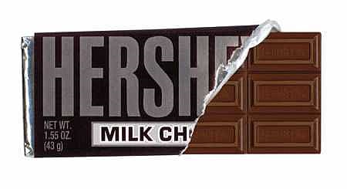
Let’s make a good chocolate!
That is,
Using Powerpoint’s color wheel
to identify R,G,B values that
generate “a good Hershey’s Brown”

